Slide 1
We help brands build their offshore teams
Delivering Quality since 2014

Slide 2
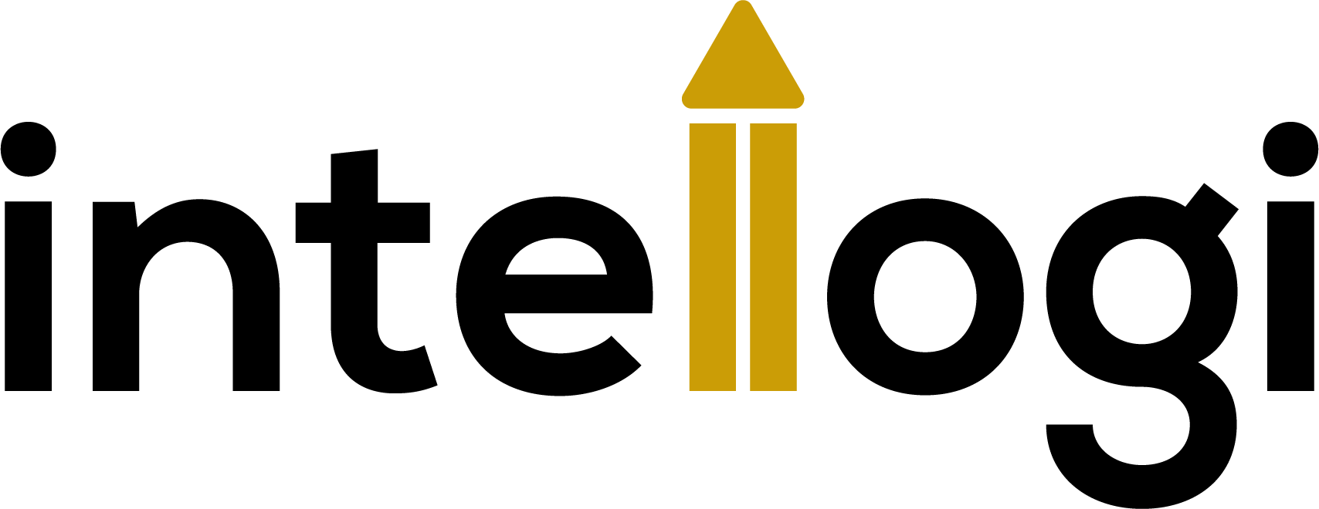
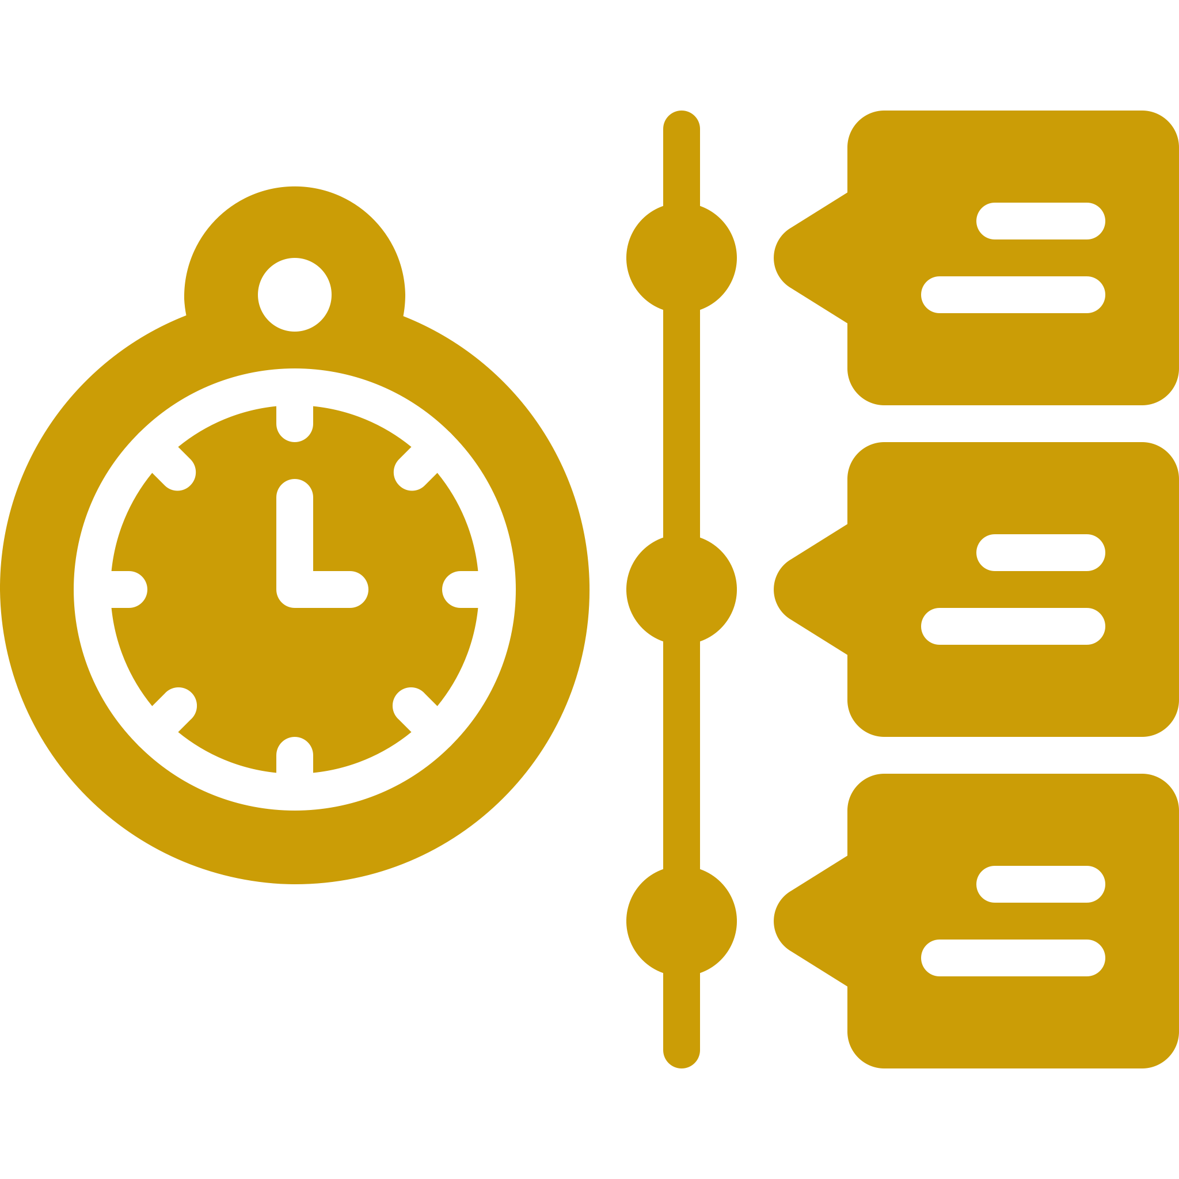
What is BOT 2.0
The Build-Operate-Transfer 2.0 model is a risk-averse & cost-effective offshoring solution that allows you to build your remote teams with zero hassle. Considering the existing risk of compromising confidentiality and intellectual property with traditional offshoring setups, the BOT 2.0 model is built for companies looking to retain control, minimize risk and maximize productivity.
Savings on Infrastructure
Cost Efficient Hiring
Economical Operations
Access a Global Talent Pool
Reduced Time to Market
Improved Productivity
If your goal is to have wide-reaching access to a global talent pool, secure your IP rights and focus on your core business proposition, BOT 2.0 is for you!
Confidential
© 2023

Slide 3
What does it solve
Say goodbye to traditional offshoring problems!
Our engagement model neutralises the risks involved with a conventional ODC set-up.
Time Zone Differences
Language Barriers
Delayed Deliveries
Process Discipline
Long Turnarounds
Data
Privacy
At Intellogi, we confront these gaps head on!
Confidential
© 2023

Slide 4
How does it work
01
Build
02
Operate
03
Transfer
Identify your specific requirements in terms of team size and skill-set
Evaluate curated profiles from a diverse talent pool within 48 hours
Execute your contract to signal the operate phase
Focus on planning your workflow while your ODC partner handles the day-to-day
Kick start your turn-key solution and focus solely on developing your IT infrastructure.
Evaluate and optimize your team’s functioning while we take care of the rest.
Prepare for the handover of all operational assets
Takeover control of your team’s payroll and retention efforts
Capitalize on your global business operations and continue to scale!
Confidential
© 2023

Slide 5
About Us – Not your traditional ODC
At Intellogi, we live by two fundamental principles; reliability & creativity. We're here to fuel your rocket ship!
We're on a journey to redefine the offshoring process and double down on what really matters - sustainable growth for our client base. India is the top choice for Global tech owing to our vast talent pool, adaptability and perseverance. Early on, we realised that the traditional ODC method was synonymous with risk, large investments and a lack of control on the client’s end. To offset this, we build our ODCs using the risk-averse Build-Operate-Transfer 2.0 model which ensures our client’s interests are safeguarded from the get-go.
87%
10M+
2
Client Retention
Development Hours
Development Centres
Confidential
© 2023

Slide 6
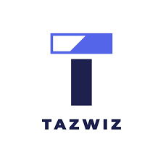
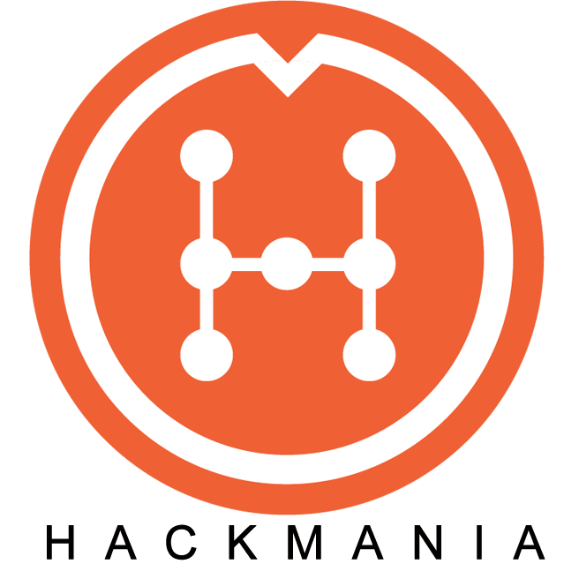
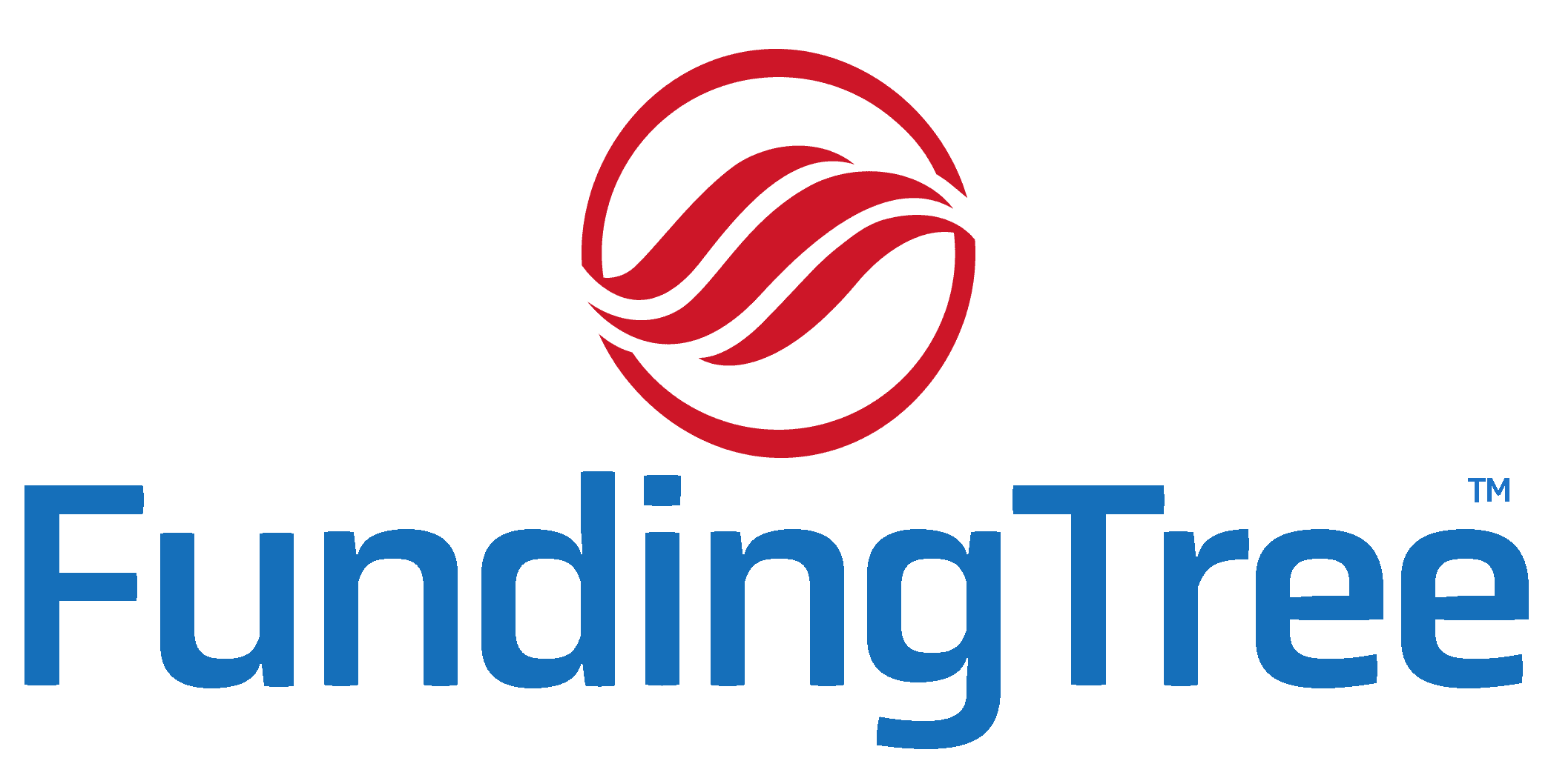
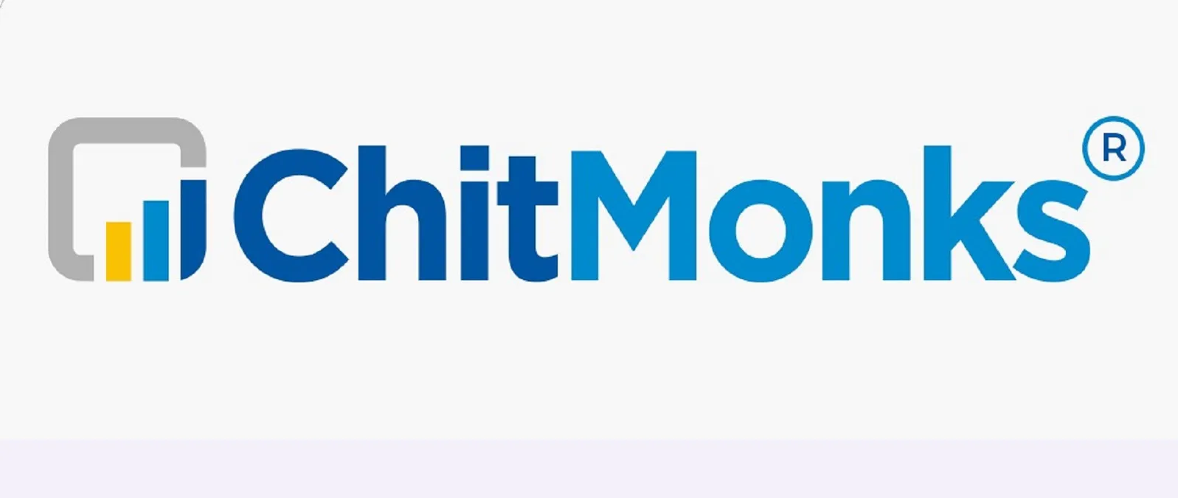
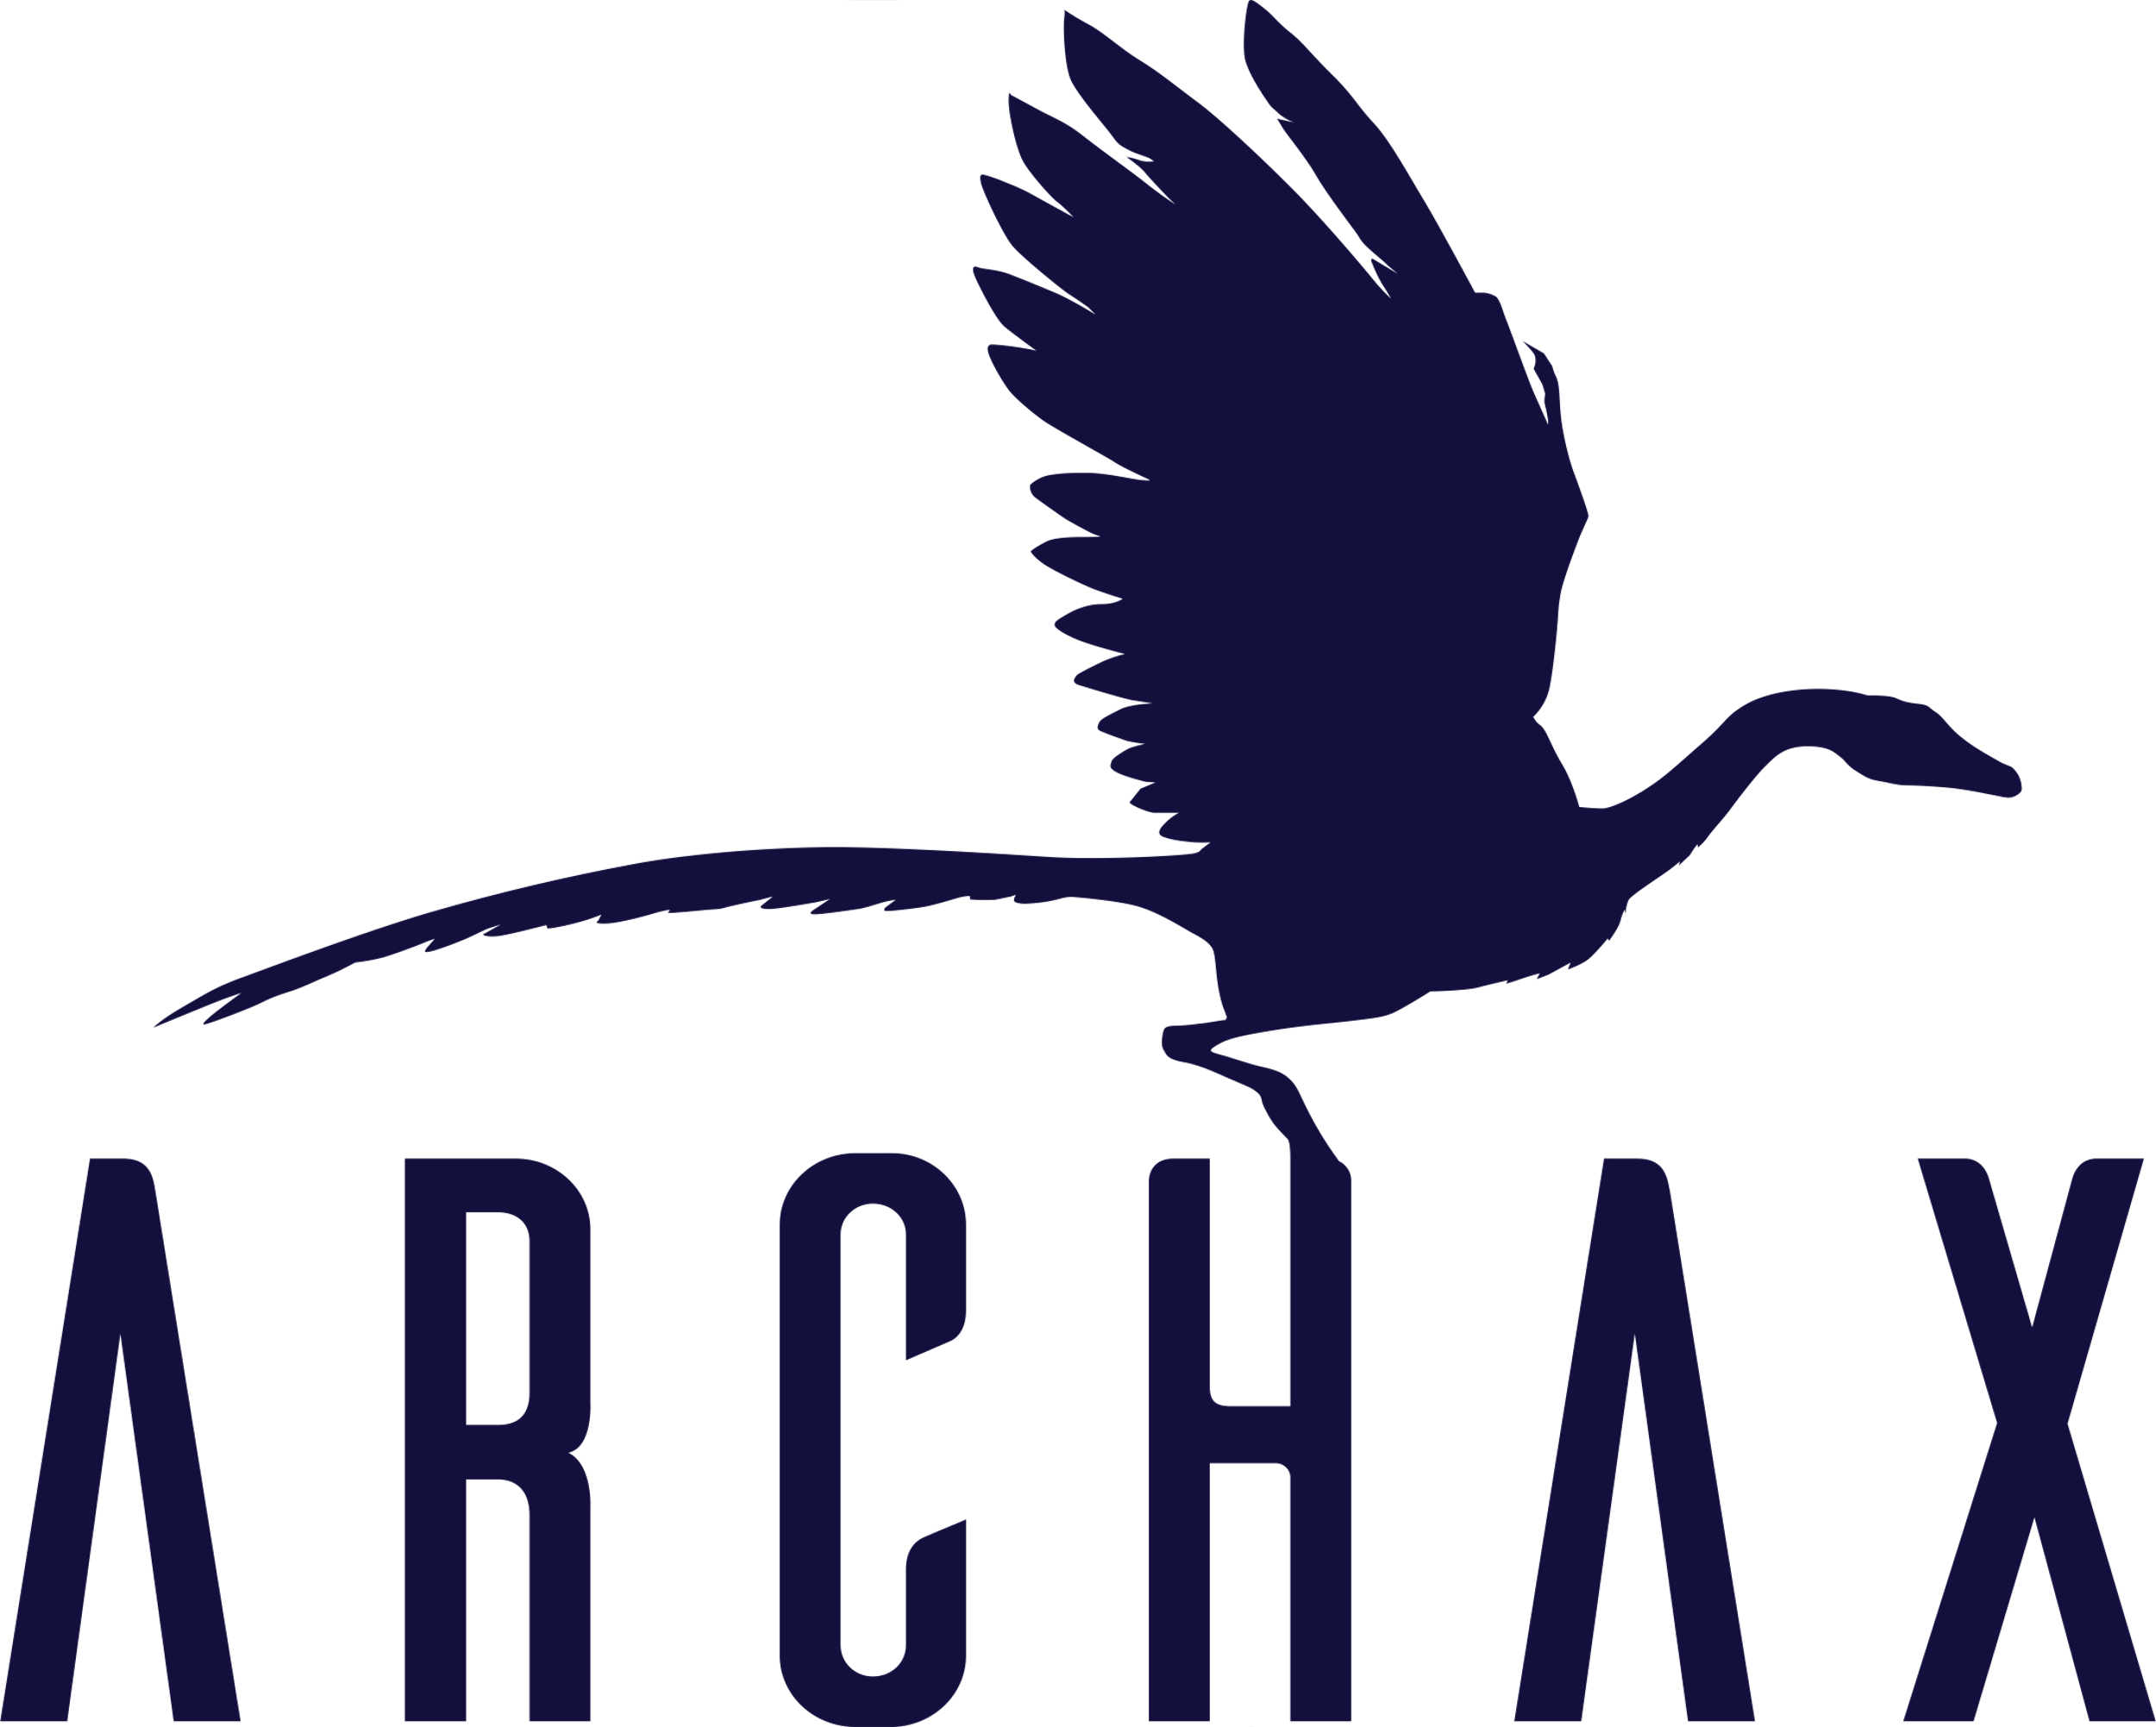
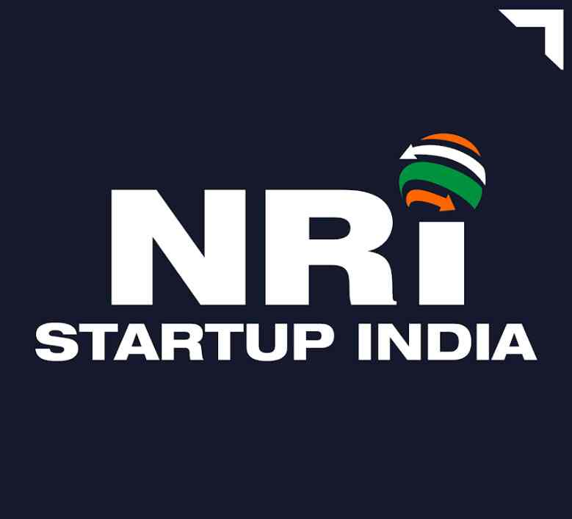
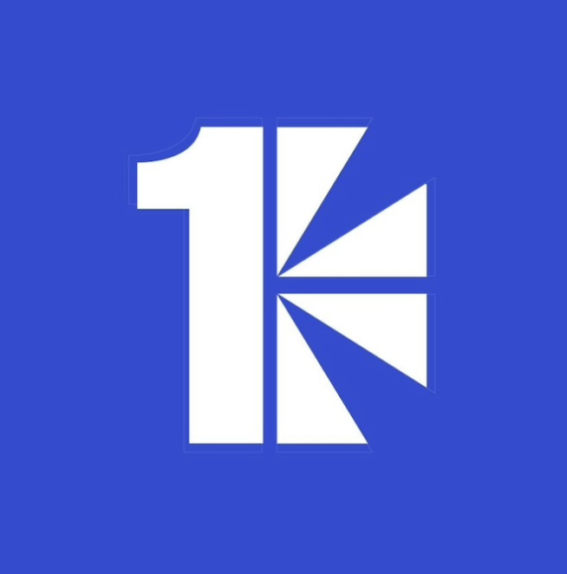
Brands that trust us
Confidential
© 2023

Slide 7
Contact us
www.intellogi.com
info@intellogi.com

